Slide 1
Data Dashboards
3 Best and 3 Worst Examples
Etana Disasa
College of Computer & Information Sciences
Regis University

Slide 2
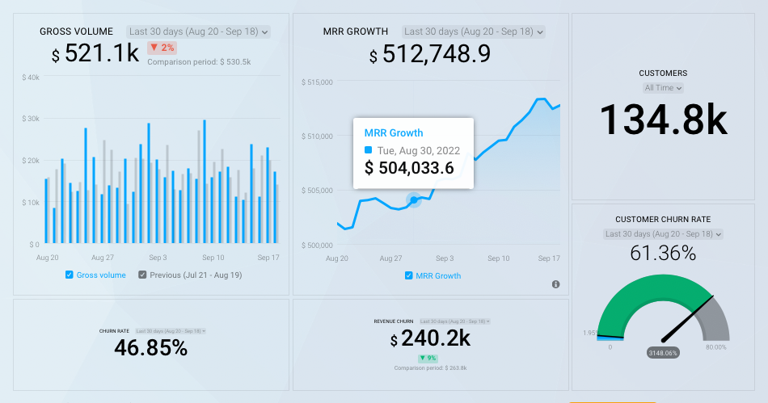
Best Data Dashboard: One
This is a template dashboard with some data source connected to it. Things that worked for this dashboard
Settle color scheme. It is not distracting. I would still make the gray bars in the bar chart a bit darker so there is contrast with the axes.
No grid lines therefore charts are easily visible.
No markers; rather, a simple mouse over displays observation.
Hovering over the bar chart also highlights the desired information.
Axis Labels are dimmer but visible enough.
It is also a live data that can be set to include current day’s data.
SOURCE: https://app.databox.com/datawall/7c95c96e907c2ca1dfda3804ae1bb852058da24e1
Notes:
SOURCE: https://app.databox.com/datawall/7c95c96e907c2ca1dfda3804ae1bb852058da24e1
This is a template dashboard with some data sources connected to it. Things that worked for this dashboard
Settle color scheme. It is not distracting. I would still make the gray bars in the bar chart a bit darker so there is contrast with the axes.
No grid lines therefore charts are easily visible.
No markers; rather, a simple mouse over displays observation.
Hovering over the bar chart also highlights the desired information.
Axis Labels are dimmer but visible enough.
It is also a live data that can be set to include current day’s data.

Slide 3
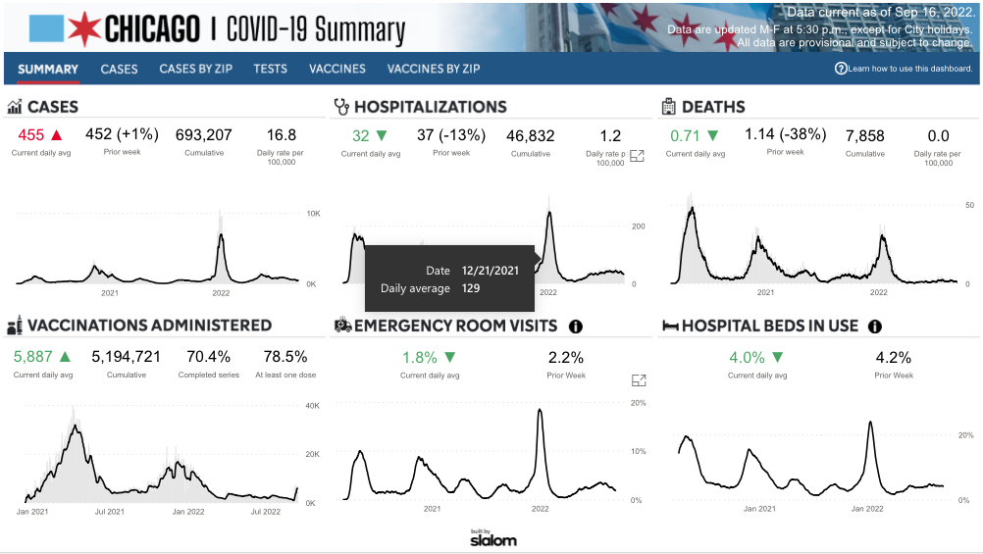
Best Data Dashboard: Two
This dashboard is the Chicago city COVID-19 tracking website.
The charts visualize essential pandemic information.
Conventional red and green colors are used to indicate negative and positive gains in that order.
No distracting colors.
Simple mouse over display of data instead of markers make it simple to learn from the dashboard.
SOURCE: https://www.chicago.gov/city/en/sites/covid-19/home/covid-dashboard.html
Notes:
SOURCE: https://www.chicago.gov/city/en/sites/covid-19/home/covid-dashboard.html
This dashboard is the Chicago city COVID-19 tracking website.
The charts visualize essential pandemic information.
Conventional red and green colors are used to indicate negative and positive gains in that order.
No distracting colors.
Simple mouse over display of data instead of markers make it simple to learn from the dashboard.

Slide 4
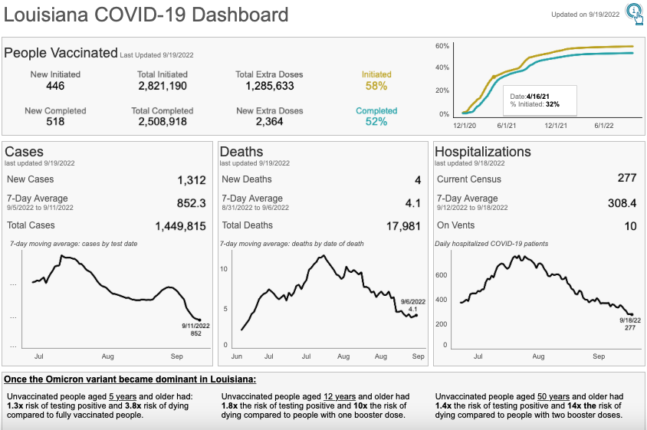
Best Data Dashboard: Three
This is the Louisiana State COVID-19 Dashboard. Here:-
It is a LIVE data; which makes it very useful.
Only essential information relevant to the pandemic were visualized.
Minimalist color usage that corresponds with the graph.
Easy mouseover displays data over all the visualization tools used.
Appropriate use of fonts faces and font sizes to display important details.
SOURCE: https://www.ldh.la.gov/coronavirus/
Notes:
SOURCE: https://www.ldh.la.gov/coronavirus/
This is the Louisiana State COVID-19 Dashboard. Here:-
It is a LIVE data; which makes it very useful
Only essential information relevant to the pandemic were visualized.
Minimalist color usage that corresponds with the graph.
Easy mouseover displays data over all the visualization tools used.
Appropriate use of fonts faces and font sizes to display important details.

Slide 5
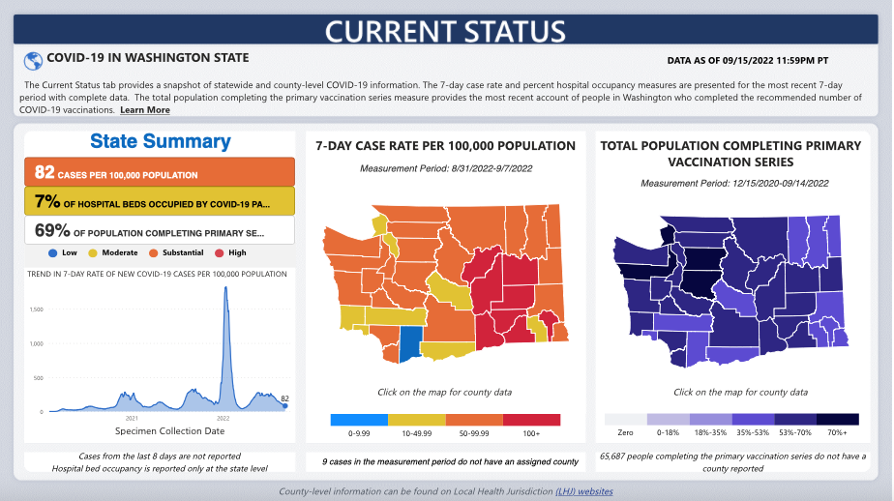
Worst Data Dashboard: One
This is the Washington State COVID-19 dashboard. There are things that work. However, I will focus on things that could be changed.
Some of the information presented could have been more simplified. “82 CASES PER 100,000 POPULATION” could have been either visualized or be used as part of other data point to showcase a more relevant information.
The same thing with ”7% OF HOSPITAL BEDS OCCUPIED BY COVID-19 PA…”, and “69% OF POPULATION OCMPLETING PRIMARY SE…” the sentences are not displaying completely.
The category colors in the first column (low, moderate, substantial and high) are supposed to be keys to the map in the second panel which is confusing. Because, similar colors are also used in the summary above it.
In comparison to other COVID-19 dashboards, this dashboard could have included more information such as COVID-19 related deaths that will bring more actionable insight to the site visitors.
SOURCE: https://doh.wa.gov/emergencies/covid-19/data-dashboard
Notes:
SOURCE: https://doh.wa.gov/emergencies/covid-19/data-dashboard
This is the Washington State COVID-19 dashboard. There are things that work. However, I will focus on things that could be changed.
Some of the information presented could have been more simplified. “82 CASES PER 100,000 POPULATION” could have been either visualized or be used as part of other data point to showcase a more relevant information.
The same thing with ”7% OF HOSPITAL BEDS OCCUPIED BY COVID-19 PA…”, and “69% OF POPULATION OCMPLETING PRIMARY SE…” the sentences are not displaying completely.
The category colors in the first column (low, moderate, substantial and high) are supposed to be keys to the map in the second panel which is confusing. Because, similar colors are also used in the summary above it.
In comparison to other COVID-19 dashboard, this dashboard could have included more information such as COVID-19 related deaths that will bring more actionable insight to the site visitors.

Slide 6
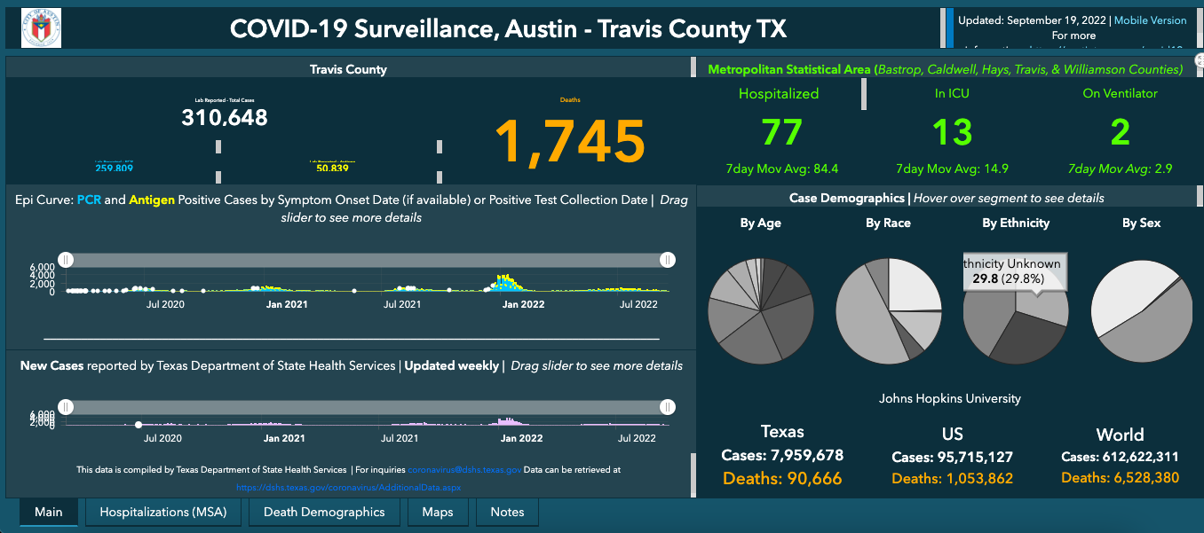
Worst Data Dashboard: Two
This is Austin – Travis County TX COVID-19 Dashboard. This is also just one of the five tabs which could be seen at the very bottom.
Lets start from the background color. It is distracting. It doesn’t work with the logo on the top left corner.
The two categorical colors used (blue and orange) indicate PCR and Antigen COVID-19 testing are very randomly used to also indicate hyperlinks and “Death” in the right bottom section.
Font sizes used are at times very large and at times very small to even read.
The Line Chart/Bar Chart (not sure) is so slim, barely any data is visible.
The markers make it impossible to see the lines/bars.
Irrelevant information such as data sources and other information could have been displayed elsewhere.
THE PIE CHARTS: Not sure if the colors are sequential or highlighting or diverging. It is confusing. (Continued in the next slide)
SOURCE: https://austin.maps.arcgis.com/apps/dashboards/39e4f8d4acb0433baae6d15a931fa984
Notes:
SOURCE: https://austin.maps.arcgis.com/apps/dashboards/39e4f8d4acb0433baae6d15a931fa984
This is Austin – Travis County TX COVID-19 Dashboard. This is also just one of the five tabs which could be seen at the very bottom.
Lets start from the background color. It is distracting. It doesn’t work with the logo on the top left corner.
The two categorical colors used (blue and orange) indicate PCR and Antigen COVID-19 testing are very randomly used to also indicate hyperlinks and “Death” in the right bottom section.
Font sizes used are at times very large and at times very small to even read.
The Line Chart/Bar Chart (not sure) is so slim, barely any data is visible.
The markers make it impossible to see the lines/bars.
Irrelevant information such as data sources and other information could have been displayed elsewhere.
THE PIE CHARTS: Not sure if the colors are sequential or highlighting or diverging. It is confusing. (Continued in the next slide)

Slide 7
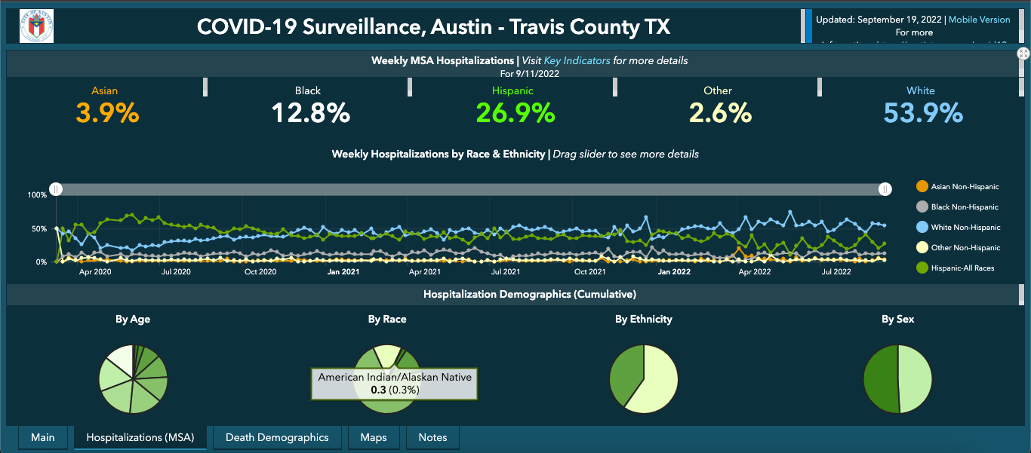
Worst Data Dashboard: Two continued…
Continued from the previous slide…
8) Look how race and ethnicity mixed in the percentage numbers listed above.
9) The PIE CHART is so frustrating to mouse over as some of the area is hardly possible to hover on. As you can see, I had to work hard to find out there were 0.3% of cumulative hospitalized patients were American Indian/Alaskan Native.
10) Again, the categorical colors are confusing. One can barely differentiate between white and light gray on the line chart.
11) The line markers are confusing. A simple bar chart with distinct colors would have been a better visualization.
12) Over all, this dashboard was disappointing in such a way that I have learned so much from it.
Notes:
Continued from the previous slide…
8) Look how race and ethnicity mixed in the percentage numbers listed above.
9) The PIE CHART is so frustrating to mouse over as some of the area is hardly possible to hover on. As you can see, I had to work hard to find out there were 0.3% of cumulative hospitalized patients were American Indian/Alaskan Native.
10) Again, the categorical colors are confusing. One can barely differentiate between white and light gray on the line chart.
11) The line markers are confusing. A simple bar chart with distinct colors would have been a better visualization.
12) Over all, this dashboard was disappointing in such a way that I have learned so much from it.

Slide 8
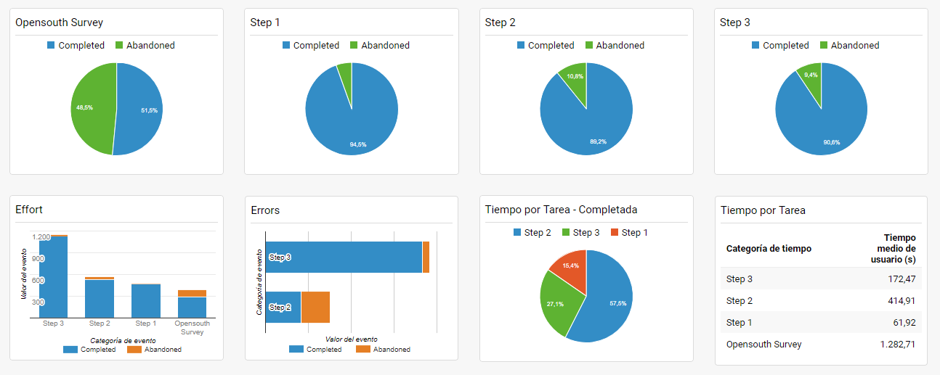
Worst Data Dashboard: Three
This is a Spanish website that posted a data dashboard to visualize results from a survey that it conducted.
Unnecessary pie charts here. A simple bar chart could have consolidated the four pie charts on top.
Appreciated the direct labeling; however, the overglow font effect makes reading difficult.
Once again, I would removed the pie chart in the second row and change it with another visualization tool.
The other bothersome thing is how unorganized the colors and the list of steps.
I appreciate how uncluttered it is; however, there is also several unused space.
SOURCE: https://carmel.es/2018/07/03/opensouthcode-resultados-de-la-encuesta-y-datos-de-la-experiencia/
Notes:
SOURCE: https://carmel.es/2018/07/03/opensouthcode-resultados-de-la-encuesta-y-datos-de-la-experiencia/
This is a Spanish website that posted a data dashboard to visualize results from a survey that it conducted.
Unnecessary pie charts here. A simple bar chart could have consolidated the four pie charts on top.
Appreciated the direct labeling; however, the overglow font effect makes reading difficult.
Once again, I would removed the pie chart in the second row and change it with another visualization tool.
The other bothersome thing is how unorganized the colors and the list of steps.
I appreciate how uncluttered it is; however, there is also several unused space.

Slide 9
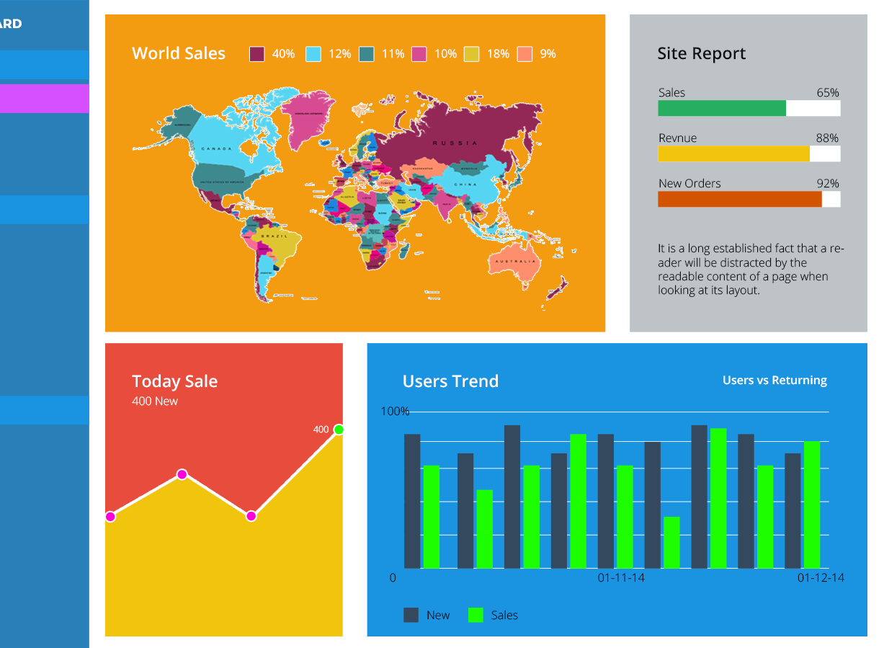
Worst Data Dashboard: Four
This is a company sales dashboard integrated into their company web portal.
Overall, there are several bright colors used which is distracting viewers from the story bring communicated.
World Sales map is too bright to see what it is showing. The percentage of sales globally would be best showed by a horizontal bar chart.
The Site Report may come confusing because it has the green, yellow, reddish colors which don’t represent any pattern.
Today Sale section uses a line chart that is colored which is unnecessary. Also, lightly labeled axes would be better.
Users Trend section; getting rid of the background color by itself would change a lot visually. Again, appropriate axis labeling is necessary.
SOURCE: https://i0.wp.com/www.fusioncharts.com/blog/wp-content/uploads/2017/12/02-Too-many-colors-1.png?ssl=1

Slide 10
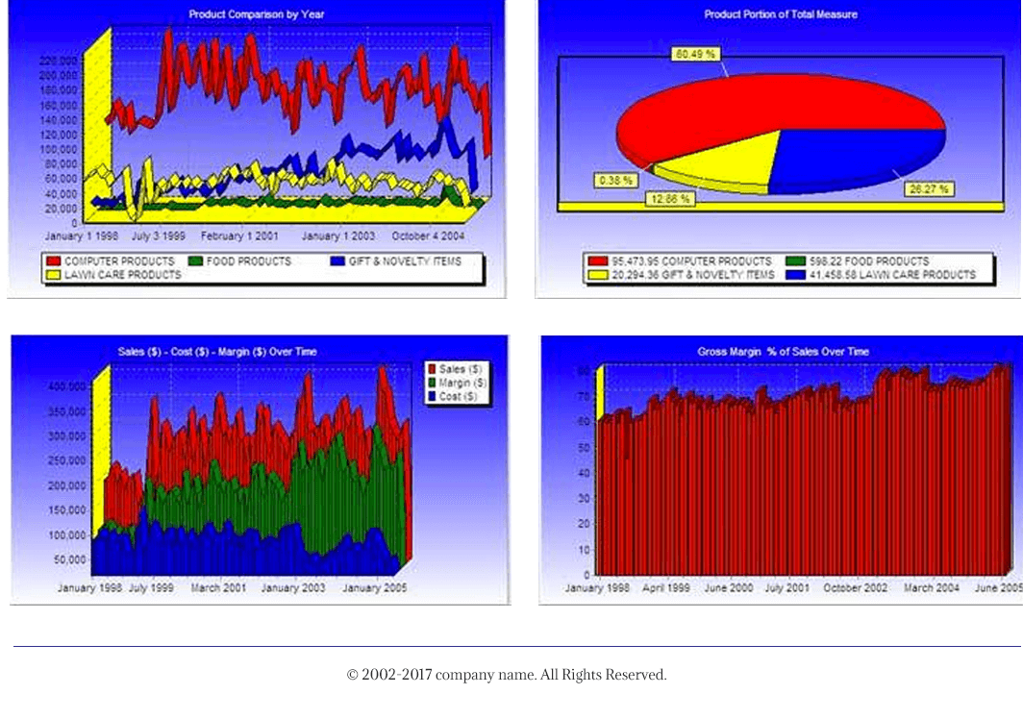
Worst Data Dashboard: Five
This dash pretty much uses ”all” graphic effects on these visualization tools.
The 3-D line charts are very difficult to see. The blue gradient background are just flat out awful looking.
The pie chart is also terrible with unnecessary border.
Next the 3-D bar charts were also just failure.
Over all, the unnecessary shads, colors, gradients, grids make these dashboard just terrible.
Furthermore, the amount of RED used makes it look like a message of urgency or alert.
SOURCE:https://i0.wp.com/www.fusioncharts.com/blog/wp-content/uploads/2017/12/10-Just-plain-ugly.png?ssl=1

Slide 11
Resources
Sources
https://carmel.es/2018/07/03/opensouthcode-resultados-de-la-encuesta-y-datos-de-la-experiencia/
https://austin.maps.arcgis.com/apps/dashboards/39e4f8d4acb0433baae6d15a931fa984
https://doh.wa.gov/emergencies/covid-19/data-dashboard
https://i0.wp.com/www.fusioncharts.com/blog/wp-content/uploads/2017/12/02-Too-many-colors-1.png?ssl=1
https://www.chicago.gov/city/en/sites/covid-19/home/covid-dashboard.html
https://app.databox.com/datawall/7c95c96e907c2ca1dfda3804ae1bb852058da24e1
https://i0.wp.com/www.fusioncharts.com/blog/wp-content/uploads/2017/12/10-Just-plain-ugly.png?ssl=1

